Slide 1
The Power of TABE Review and Updates
2021

Slide 2
TABE 11&12 Overview
Standardized Assessment
First Released in 1967 with Version 1&2
Five content levels (lowest to highest)
L, E, M, D, A
Two Forms
Currently 11 and 12 were released January 2018
Four subject areas
Reading, Math, Language & Writing
Alignment to National College and Career Readiness Standards (CCRS)
HSE exams also align to CCRS
Notes:
Quick opening with info that everyone should know already.
-Over 50 years of TABE
Content covering beginning grade school levels through High School (and beyond with new CCRS)
Current forms are 11&12 but 13&14 are being to be outlined. Current NRS approval ends in early 2024.
New TABE Online system will be Adaptive which will shorten the test with no locator and no levels. More details to follow in 2022.

Slide 3
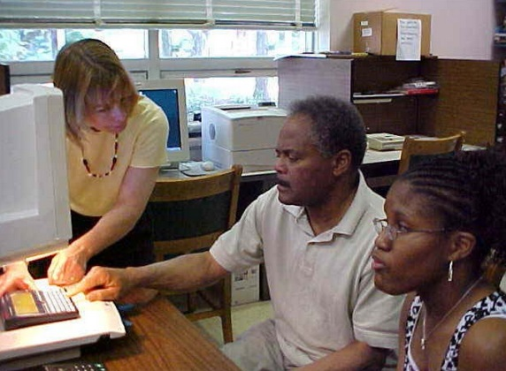
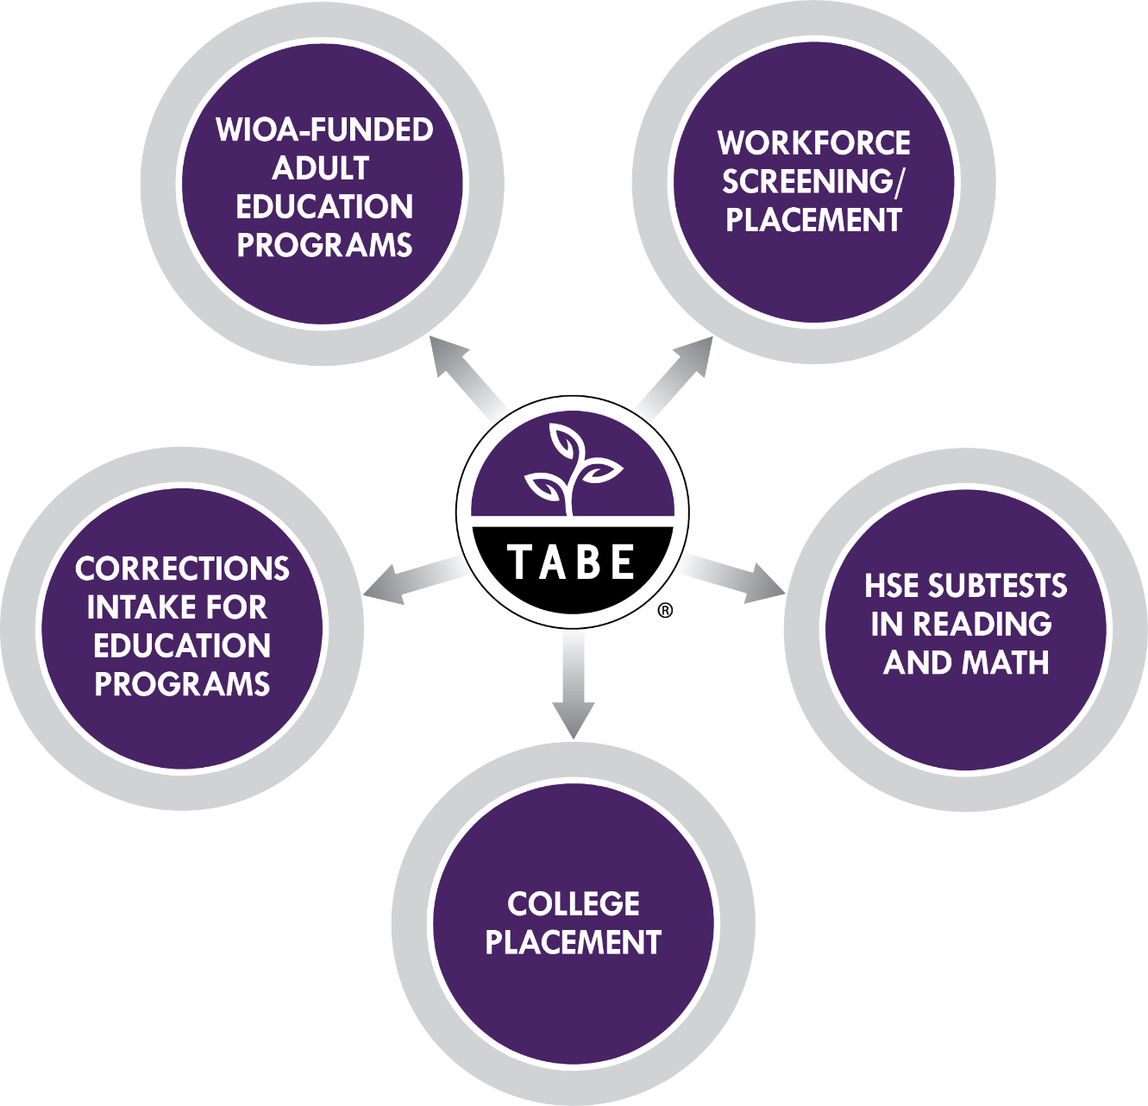
TABE Multiple Uses
Notes:
Older slide to point out the different types of programs that could use TABE.
Top Left is the main customer using TABE for NRS reporting
Top Right is Workplace readiness either as part of Career Tech programs or even private industries like police, manufacturing, healthcare.

Slide 4
TABE CLAS-E
TABE CLAS-E Forms Paper and Online
Include Reading, Listening, Writing and Speaking
Updated from current forms A&B
NRS application Fall 2021
TABE CLAS-E Online
INSIGHT Testing Platform – Same as TABE 11&12
Educator Scoring within INSIGHT for Writing and Speaking tests
TABE CLAS-E Reports and Data
Updated and additional reports released Summer, 2021
Auto-Locator added Summer, 2021
Designed specifically for adult English language learners
Notes:
Introducing TABE CLAS-E to those that might not know about it.
Been around in paper format for several years but Online was released this year.
CLAS-E Online uses some Insight portal as TABE 11/12 so staff does not need to be retrained.
Writing and Speaking does use local Educator Scoring with Rubrics to complete the scoring.
Reports are similar to 11/12 and a sample is in the later section of this presentation
A CLAS-E data extract is due out in late Sept/early Oct that will have all testing history and will also have Skill data similar to the TABE 11/12 Strength and Weakness reporting.
CLAS-E and all NRS approved ESL tests need to have re-approval from the NRS my early 2023 and we are Refreshing CLAS-E. Only updated about 25% if the items and not change is the high level Objectives
Recorded webinar posted to TABEtest.com for more details.

Slide 5
DRC INSIGHT Portal
Accessed through a web browser:
IE, Edge, Firefox, Chrome, Safari
URL: https://tabe.drcedirect.com
https = secure site, transmission of data is private
Requires Login ID and Password
24/7 access to your information
Students
Test Administrations
Reports
TABE 11/12 Online and CLAS-E Online both use the same Insight Platform
Notes:
Reiteration that Insight is a single platform for 11/12 Online, CLAS-E Online, 11/12 Scanning and for some parts TABE Off-line

Slide 6
TABE Off-Line
Now available
A fully offline and secure testing experience for correctional education
Easy to use for TABE administrators
Easy to use for students with little or no experience testing on computers
Pilot started in February with Texas Corrections – 97% reduction in administrative staff time
Utilizes TABE Online Portal for Administrative Registration
Students Test on non-internet connected computers
Responses are uploaded to TABE Portal for Scoring and Reporting
Notes:
Introducing TABE Off-line.
Available now for corrections and programs that might have low bandwidth.
Digital version of the paper test. (sample on next slide)
Most admin features can be done completely off-line including registering for tests, scoring the Locator and tracking progress.
Online connection needed to transmit responses to Insight Portal for scoring and reporting.
Recorded webinar posted to TABEtest.com for more details.

Slide 7
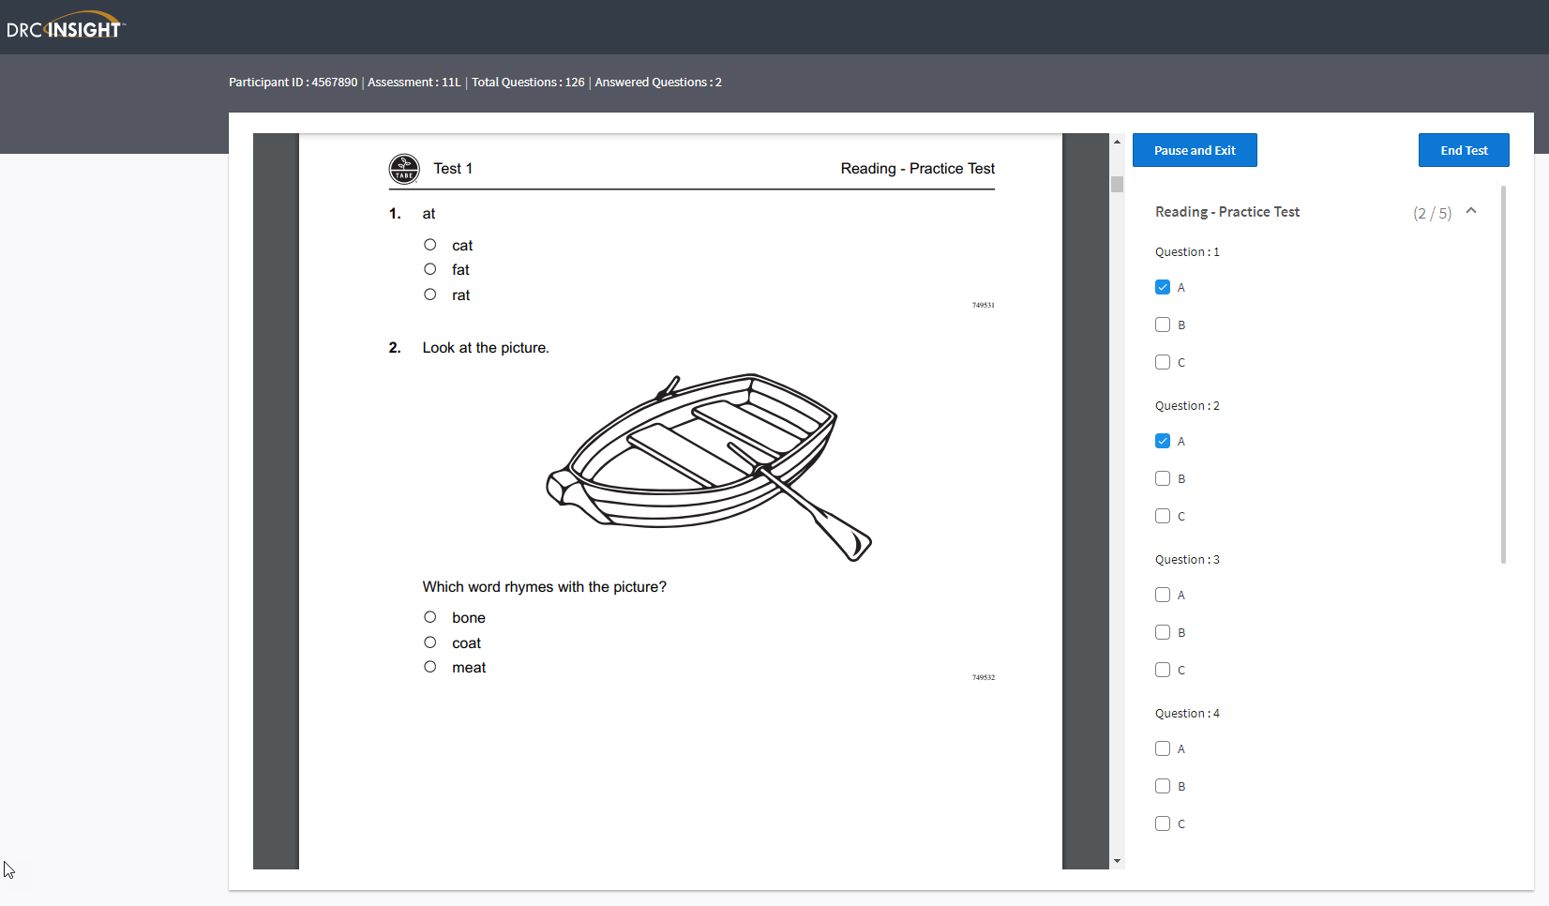
Notes:
Sample of the student testing screen
Left side is a digital version of the test book
Right side is an active answer sheet.
Currently the timing is done locally like the paper test but a built in timer is being worked on
Currently the calculators are local hand held similar to the paper test but a built in calculator is being developed.

Slide 8
TABE 11&12 Writing

Slide 9
TABE 11&12 Writing
Released on February 1, 2021
In-Person Testing only, not available via Remote or paper testing
NRS approval pending
Applicable for students that test into Levels M, D, or A
One Level, no Locator used
15 Multiple Choice Questions – One Argumentative or Informative Essay
Local Educator Score Used for Essay
9
Notes:
New Writing test is not yet NRS approved but once it is states would then decide if they will add it to the Assessment policy as an optional test to measure NRS gains.
Could be used by HiSET states to help with the essay portion or for Career programs that need writing proficiency.
Recorded webinar posted to TABEtest.com for more details.

Slide 10
TABE and High School Equivalency
TABE and High School Equivalency (HSE) Tests are aligned to the College and Career Readiness Standards (CCRS)
TABE 11/12 was designed to support a pathway to High School Equivalency and beyond
In states where adult learners are tested multiple times, is it necessary to require all subjects of a High School Equivalency test where TABE is being used?
TABE can help support an alternate path to fulfill those state requirements
Depending on the level of TABE, states using this assessment have already assessed many of the same content areas and standards
TABE 11/12 HSE White Paper
Concordance Report on TABE to HSE tests posted on TABEtest.com
Notes:
- New Research done by DRC after collecting data from several states of students that took TABE and then went on to take a HSE test.
More notes on the next slides.

Slide 11
TABE and HSE Concordance
11
Notes:
For Reading a score of 536 on Level M or above on TABE has a strong likelihood of passing any of the HSE reading tests at a basic level which is the equivalent of completing High School with C’s and D’s for grades. You graduated but are you ready for the rigors of a good job or of post secondary requirements?
Continuing within a free (very low cost in a fee states) Adult Ed program would allow you to be better prepare to perform at a higher level on TABE (Level D or A) and then get to the higher college and career Ready cut score on all HSE tests.
536 on TABE level M is the start of NRS Level 4 (out of 6 levels). This demonstrates the increase of rigor created by the US Dept of Ed for WIOA Title 2 programs to follow. The goal of the higher levels of the NRS is to better prepare students to succeed on the HSE tests and then excel at post secondary or workforce programs. Not simply pass at a minimum level.

Slide 12
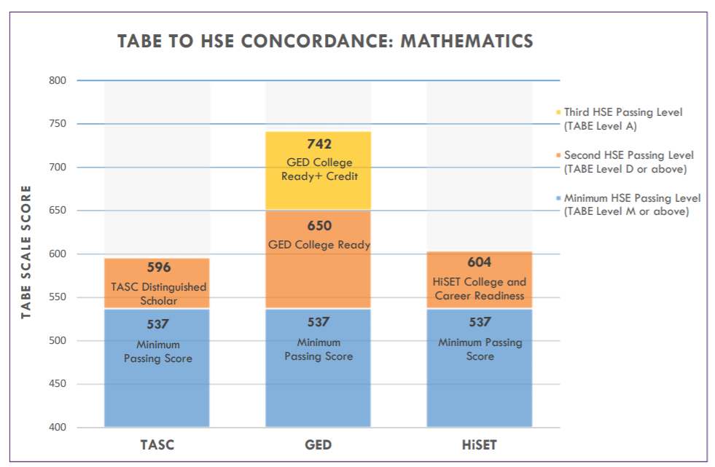
TABE and HSE Concordance
12
Notes:
- For Math the score is 537 on Level M or above which is also the start of NRS Level 4.

Slide 13
TABE Reports
TABE 11&12 Individual Profile
TABE 11&12 Individual Portfolio
TABE 11&12 Bulk Export (state-level option)
TABE 11&12 Roster Group Report
TABE 11&12 Local On-Demand Extract (local option)
13
Notes:
Review the report types available to Scanning, Online and Off-Line.
Main report is the first one the Indiv Profile
The Local On-Demand Extract has immediate scores if the PDF reports that should be ready in 15-20 minutes are not fast enough.
We also send the bulk export nightly to all LACES data system states and a few other states with local data systems.
The Bulk Export will add in early Oct all the Stength and Weakness data from paper 2&3 of the Profile report into the excel data file. We are working with Curriculum partners like Aztec, Essential Ed, Burlington and New Readers Press so that their systems could be able to read this data file and plan custom learning paths for individual students.

Slide 14
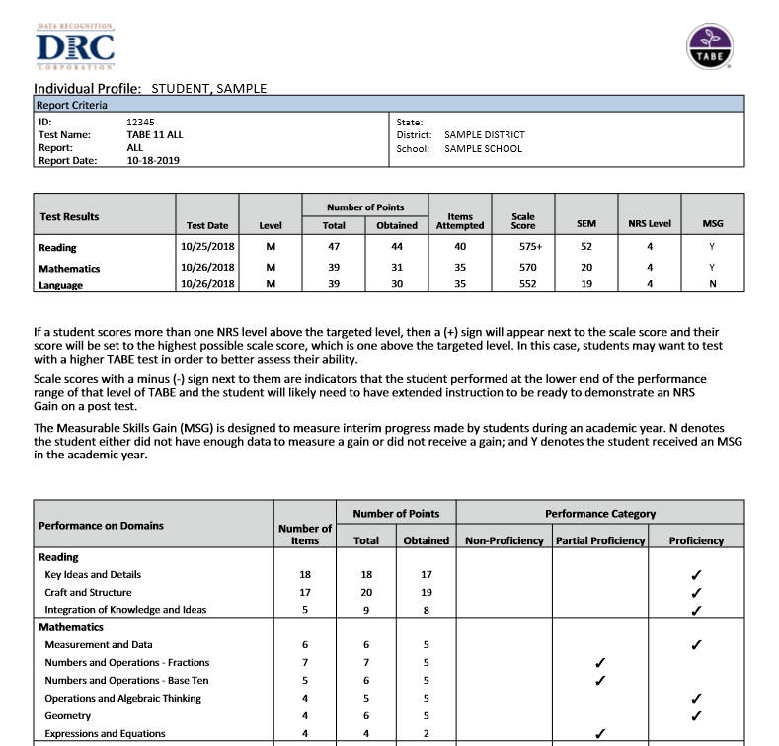
Individual Profile
Notes:
Point out MSG column on tracks improvements from July 1 of each year which is the start of the federal year.
The lower red box helps understand where the 2 point questions are and what section have the most overall points.

Slide 15
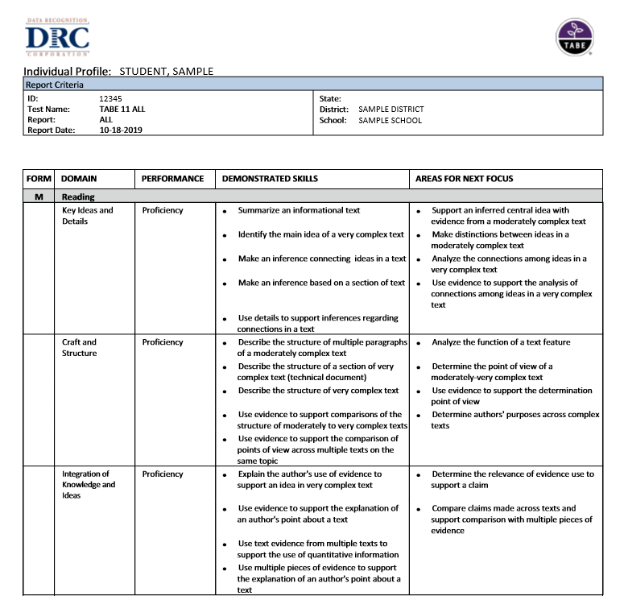
Individual Profile
Notes:
These Strength and Weakness areas can help drive instruction and improve NRS scores on the post tests.
Being added to the Excel data extract file for more digital uses.

Slide 16
TABE CLAS-E Online Individual Report
Notes:
CLAS-E report is similar to TABE 11/12
Strength and Weakness section (page 2 and 3) is close to being completed and published.
Working on the ability to run this Profile for previous tests like you can with 11/12. Currently this report only pulls up the most recent test data.

Slide 17
TABE 11&12 Resource Materials
TABE DRC INSIGHT Portal – General Information > Documents
DRC INSIGHT Documentation
TABE 11&12 Scoring Guide
Test Administration Manual
Test Directions
TABETest.com (under Resources)
Sample Practice Items
Objective Structure
Test Blueprints
TABE Online Training Videos
Accommodation Guidelines
HSE Concordance
Visit tabetest.com for all updates and info
Notes:
Best place for more information is TABEtest.com under the Resource section
The secure Portal also has manuals, Test Direction and scoring Guides.

Slide 18
Linking to Curriculum
Data file to include TABE Strength and Weaknesses
Upload into Learning systems to develop custom learning paths
Resources from Publishers share on webinars
Notes:
-Reemphasizing that the updated data file will help target instruction and future webinars will be held.

Slide 19
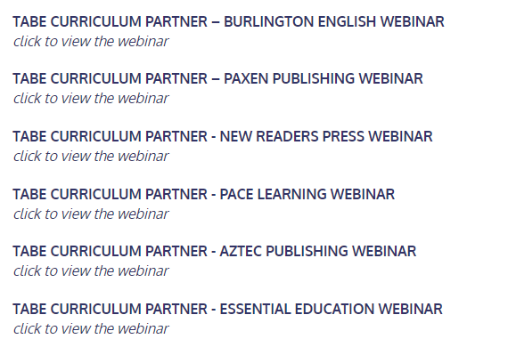
TABE Webinar Series
Notes:
Example of the recorded webinars that we did with each publishing partner

Slide 20
TABE Workforce Readiness Report
Planned for late 2021/early 2022
Aligning to Dept of Labor O*Net Bright Outlook Jobs
Partnership with MetaMetrics to align TABE Reading and Math to Lexile and Quantile Scores
Provides new normed data for Grade Equivalents
Notes:
Brief overview on a new Workforce Report planned for Spring 2022.
Aligning the top “Bright Outlook” careers from the Dept of Labor’s O*Net site with the Reading Lexiles and Math Quantiles.
MetaMetrics has already Lexile and Quantile the reading and math requirements for these in-demand jobs
We just completed a research study to align TABE Scores to Lexile and Quantile Levels.
New report is now being created to show the relationship of a TABE Reading and Math score to the requirements of the in-demand careers.
More details later this year.
Also, will help provide better alignment to realistic Grade Level performance since Lexiles and Quantiles are normed

Slide 21
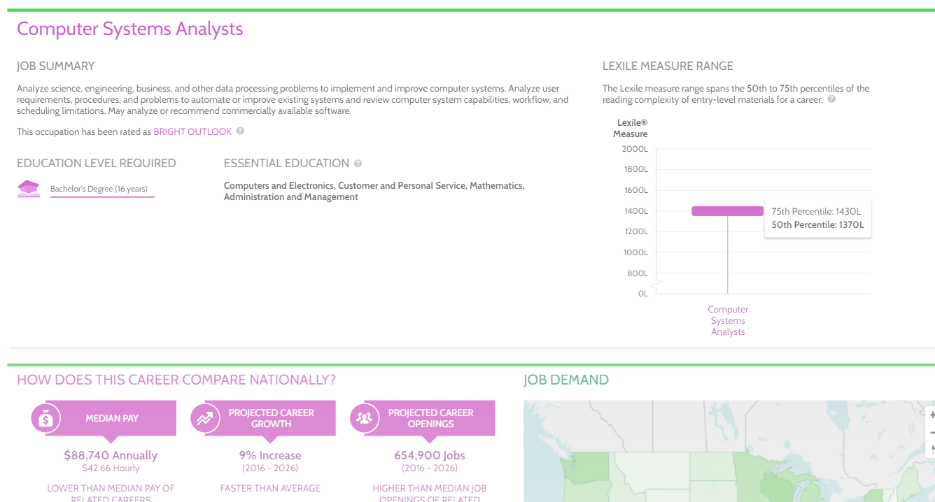
Notes:
This is a sample of a resource from the MetaMetrics site (not the new TABE Report) that shows an “In-Demand” career as a Computer System Analysts. On the bottom it lists some career details about pay and opportunity growth and on the right is shows the expected Lexile Reading level of this career. We are now working to add the TABE Reading to this data in the new Workforce Report.

Slide 22
Discussion Questions
Q & A

Slide 23
Thank You! TABE Support 866-282-2250 TABETest.com

